Slide 1
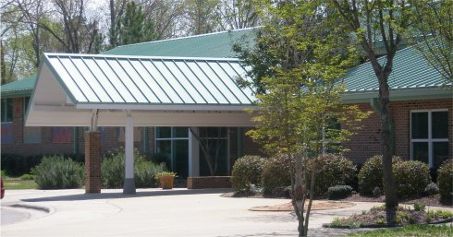
Welcome to Open House
Mrs. Kirk, Mrs. Lucas and Mrs. Meares

Slide 2
Daily Schedule
8:45-9:15 Arrival 9:15-9:40 Morning Meeting/Intervention
9:40-11:00 Literacy/Centers/Daily Five 11:05-11:35 Lunch 11:35-12:00 Writer’s Workshop
12:00-1:00 Math
1:10-1:55 Specials
1:55-2:05 Snack
2:05-2:30 Letterland
2:30-3:00 Recess 3:00-3:40 Rest/Social Studies/Science 3:45 Dismissal

Slide 3
Daily Five
Research based
Will begin 2nd Quarter
The five components are:
Read to Self
Read to Someone
Listen to Reading
Word Work
Writing
Guiding Reading
Small group instruction
Baggy Books
Read nightly
Will begin at different times

Slide 4
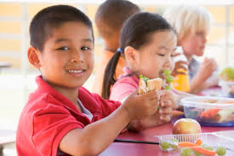
Lunch
Time
11:05-11:35
Visiting at lunch
Please wait to join your child until Sept. 24th.
Wait at the end of the hallway.
Sit at a center table.
You may invite another child to join you.
You can bring lunch for your child but not for any other students.

Slide 5
Specials
Our specials’ schedule will change each quarter.
P.E. - must wear tennis shoes to participate
Art - wear old clothes
Media - return library books

Slide 6
Snack
Send a small, healthy snack each day for your child.
Please put the snack in a Ziploc bag labeled with your child’s name.
To make the morning routine easier for your child, please pack snack separate from your child’s lunch.

Slide 7
Writers’ Workshop
Telling a story with a picture
Adding text
Avoid spelling for your children
Listen for the sounds
Types of writing
Narrative
Expository
Opinion

Slide 8
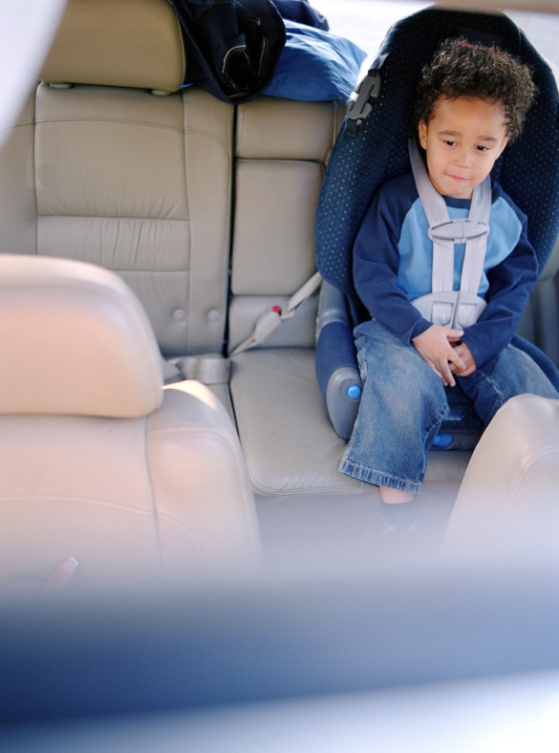
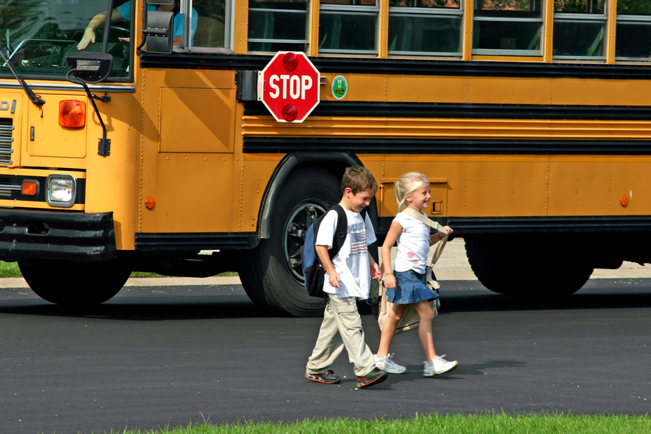
Dismissal
Be consistent
Write a note if there is a change

Slide 9
Curriculum
For more information on the kindergarten curriculum you can look on the Wake County website—www.wcpss.net

Slide 10
Report Cards
At the end of each quarter
Based on standards
Unable to perform standard
Performs standard with support
At standard
Well above standard

Slide 11
Conferences
Available anytime upon request
kkirk@wcpss.net and llucas3@wcpss.net
Avoid “dropping in” to have an informal conference.
Conferences will occur at the end of the first and third quarters at Wakefield.
November 13th and April 9th – East Millbrook Middle School will host conferences.

Slide 12
Communication
Website
www.mrskirkandmrslucas.weebly.com
Monday folders
Review and remove work
Return folder and bag on Tuesday
E-mail
kkirk@wcpss.net and llucas3@wcpss.net
and pmeares@wcpss.net

Slide 13
Attendance
Absences
All absences are marked unexcused until we receive a note from you.
Send a note or e-mail to school within 2 days of child’s return to school.
Children who leave before 12:30 will be marked absent.
*** Please keep your child home from school if your child has had a fever within 24 hours or has vomited within 8 hours. ***

Slide 14
Behavior Management
Involves dialogue, modeling and coaching leading to independent problem solving
Our goal is to make sure children understand the choice they made and what they could have chosen to do differently.
While here at school, we are a school family with a happy and safe learning environment.
We often use the terminology: “were your actions helpful or hurtful”?

Slide 15
PBIS FEATHERS AND TICKETS
School wide behavior program to promote positive behavior
Class can earn feathers
Individual students can earn tickets
Students store these tickets in our classroom
Students can then ‘spend’ their tickets each month in our Eagle Store or save their tickets until the next month

Slide 16
Scholastic
Scholastic orders will be coming home monthly
Online or send into school with exact cash or check (we can not make change)
Checks made payable to: Scholastic Reading Club
Online code is: NHRLD
Great way to build your home library with books on your child’s level
We earn points to build our classroom library when you buy books

Slide 17
Volunteers
We’d love your help to:
Read aloud
Work on items at home
Work with small groups/individual children
Chaperone field trips
Must be registered through Wake County, please stop by the computer lab today.

Slide 18
Reminders
Extra change of clothes
Safety pin important notes to the backpack
Please e-mail us in advance when sending birthday treats. We have a few allergies this year.
No flip flops!
When sending in money for PTA events, etc., please keep in mind to send in exact amount. Our school is unable to make change. Thanks.
Field Trip forms
Personality Train

